Slide 1
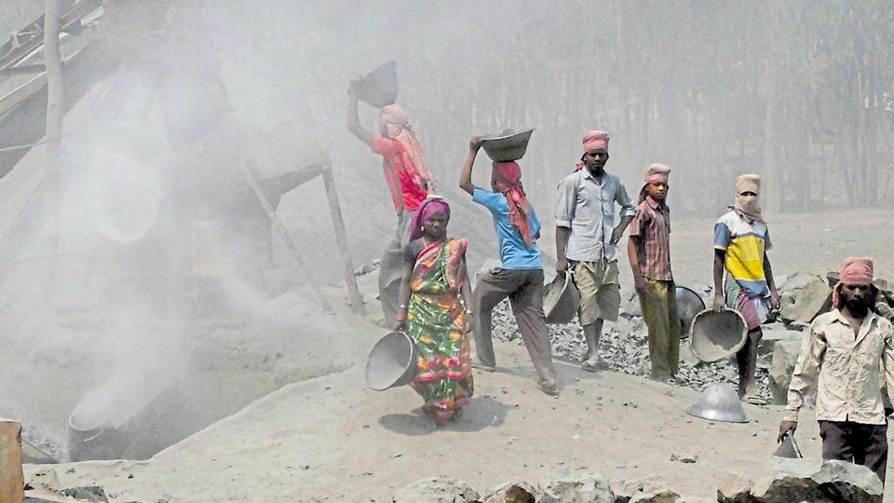
Prevention of dust-inhalation among stone-cutter workers

Slide 2
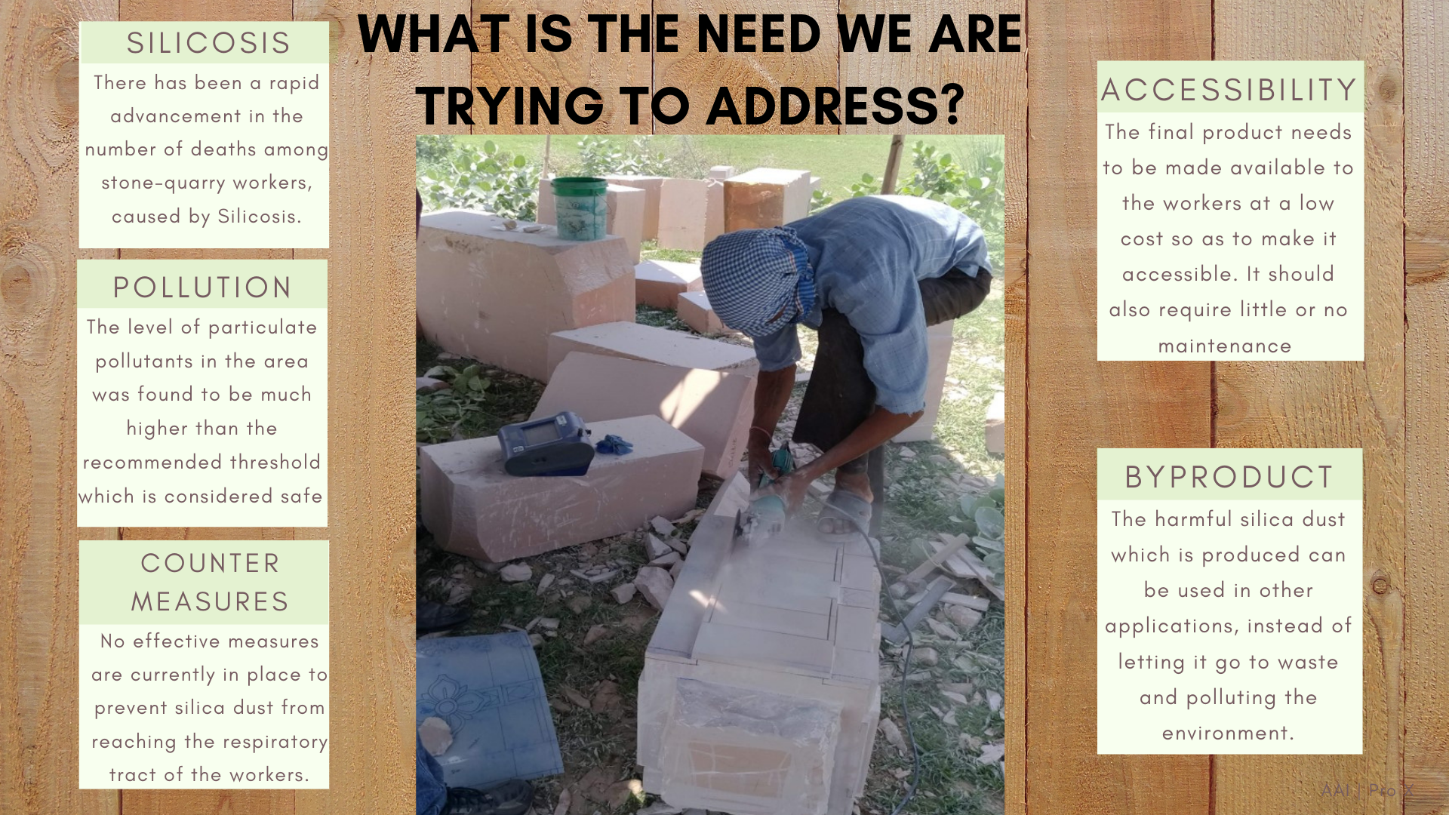

Slide 3
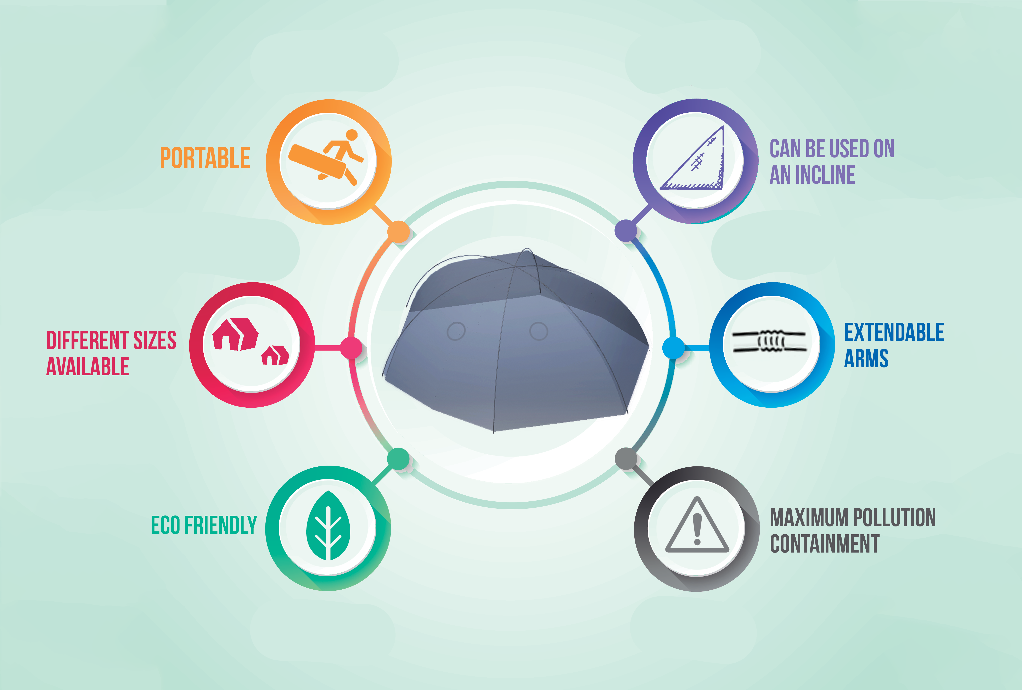

Slide 4
Background work
The project is new and has just gone through the formulation stage at present.
Data has been recorded for the levels of particulate matter of various sizes in the air around the stone industries of Bharatpur and the effectiveness of alternate solutions to the problem was analyzed.
During the interaction with the masons, it was found that the masks which are currently in use get clogged within short time and cause labored breathing.
It was also realized that spraying water was not possible everywhere due its paucity.

Slide 5
At the end of project.
By the end of the project, we wish to deliver a proof-of-concept prototype which can be extended to a field-deployable functional prototype, implementable as an integral part of the mining process. Consequently, hazardous health conditions for the stone workers could be avoided. The cost and availability of the materials used for making the product will be taken into account since the ultimate aim is to make it as accessible as possible for its applicability in real life situations.
The product is, in essence, a dom-shaped foldable structure which surrounds the work piece entirely; with two holes having extendable telescopic arms protruding towards the interior of the dom. This would allow the stone cutter a wide range of movements to carry out their tasks. As the material of the sheets to be used will have high transparency, it would not hinder the visibility of work piece.
Our product aims to have a wide applicability ranging from marble and sandstone cutting to all sorts of small scale manual labor involving hazardous particulate matter entering the atmosphere

Slide 6
Water
Power
Ventilation holes cannot be used in open atmosphere as the dust would still be in the air.
Cannot use urban techniques so have to apply innovation
Stone dust usage after collection

